Slide 1
Ensemble Learning: Boosting
Presented by :
Vishrut Maheshwari
Harsh Dubey
Mehul Saxena

Slide 2
Ensemble learning:
Ensemble: In+simul = in + all at the same time
Combining several base models in order to produce one optimal predictive model.
These individual based models are also known as weak learners.

Slide 3
Example :
I want to invest in a company XYZ but I am not sure about it’s performance.
Employee of the company XYZ - knows internal functionality of the company but lacks a broader perspective on how the competitors are innovating, how the technology is evolving and the impact o evolution on their company’s product.
Financial advisor - Has a broader perspective but lacks the view on how company’s internal policies are fairing off.
Stock market trader - He knows the seasonality trends and how the overall market is performing.
cont...

Slide 4
Cont ...
Employee of the competitor - knows the internal functionality of the competitor firms and is aware of certain changes which are yet to be brought. Lacks the sight of company in focus and the external factors which can relate the growth of the competitor.
Market research team - This team analyses the the customer preference of company XYZ’s over how it’s changing with time. As this team eals on the customer sie it is unaware of the internal changes of the company.
Social media expert - This person will help us understand how the company XYZ has positioned its product in the market and how the sentiments of public is changing with respect to time towards the company. What if we can combine all the results ?

Slide 5
Weak learners
No matter whatever the distribution is it’s always better than random guessing, when it comes to label the data.
Random guessing is threshold for decision making. Any algorithm is designed above it.

Slide 6
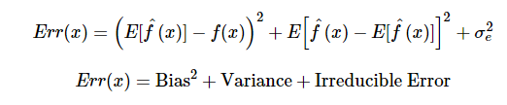
Error in ensemble learning :
The error emerging from any model can be broken down into three components :
Bias error - how much on an average the predicted values differ from the actual value. A high bias error means our model keeps missing important trends .
Variance - how the predictions made on the same observation different from each other. A high variance model will overfit your on your training population.

Slide 7
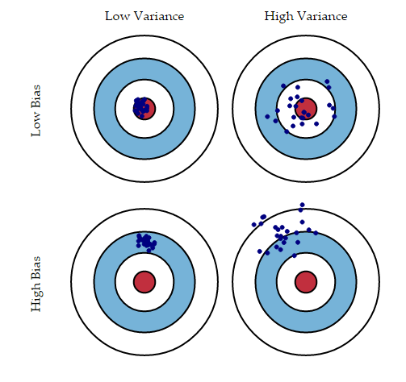

Slide 8
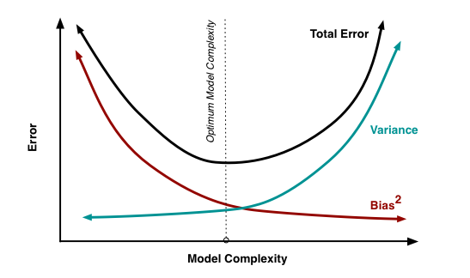
As we increase the complexity of our model we will see reduction in error due to less bias and if we continue with the same process we will end up overfitting and hence our model will suffer with high variance.

Slide 9
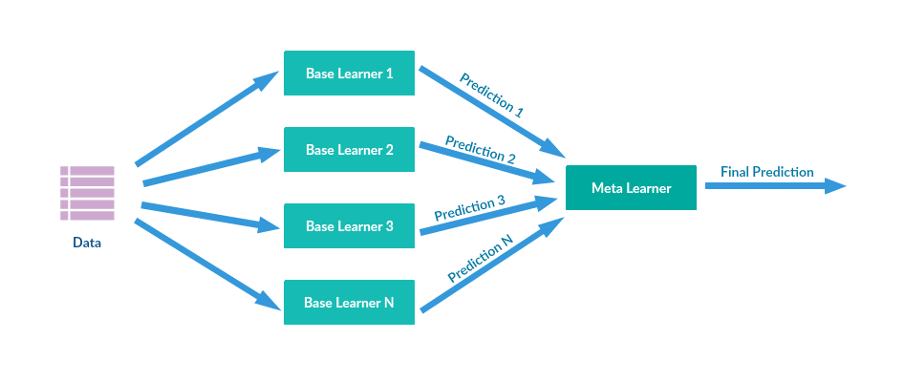
Overview on stacking :
Stacking is another ensemble model, where a new model is trained from the combined predictions of two (or more) previous model. The predictions from the models are used as inputs for each sequential layer, and combined to form a new set of predictions.

Slide 10
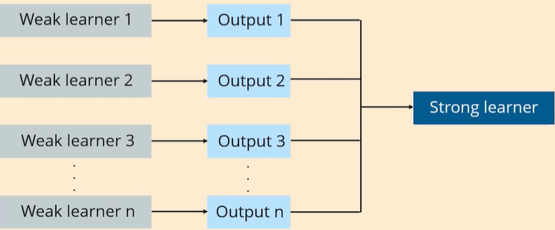
What is boosting?
Boosting is a process that uses a set of Machine Learning algorithms to combine weak learner to form strong learners in order to increase the accuracy of the model.

Slide 11
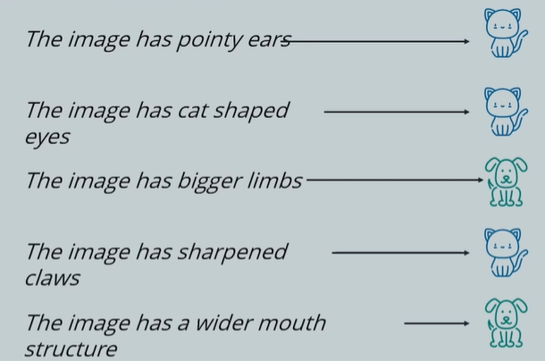
Why is Boosting needed?
These rules help us identify an image is a Dog or a cat.

Slide 12
Why is Boosting needed?
But if we were to classify an image based on an individual(single) rule, the prediction would be flamed.

Slide 13
Why is Boosting needed?
Each of these rules, individually, are called weak learners because these rules are not strong enough to make predictions.

Slide 14
Why is Boosting needed?
Each of these rules, individually, are called weak learners because these rules are not strong enough to make predictions.
Ensemble learning combines several weak models to generate better results. This can be done either parallely or sequentially.

Slide 15
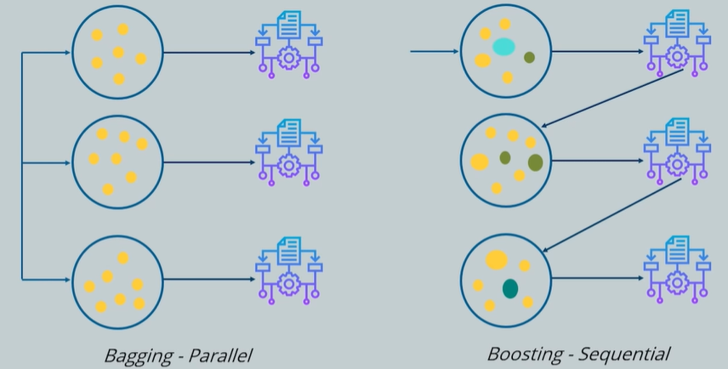
Why is Boosting needed?
Parallely is bagging. Sequentially is boosting.

Slide 16
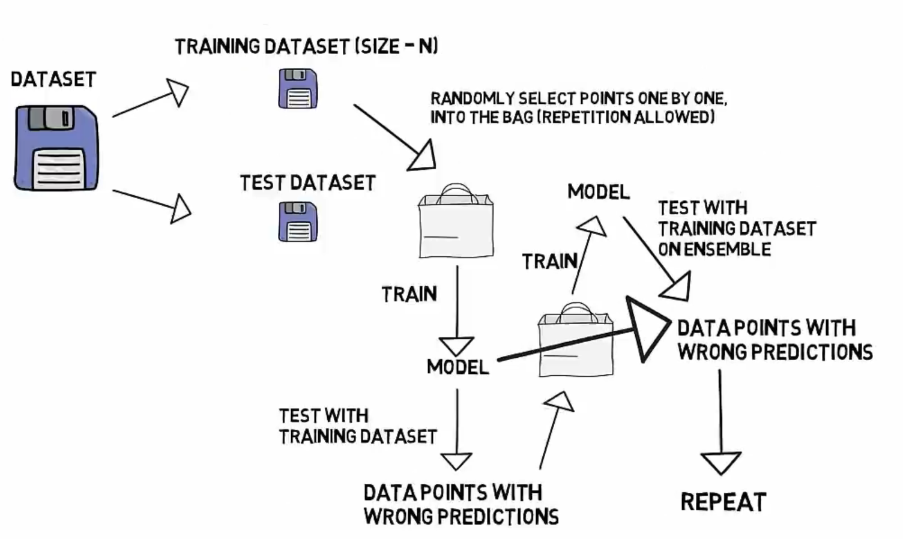
How boosting Algorithms works?

Slide 17
How boosting Algorithms works?
Step 1: The base learner takes all the distributions and assign equal weight or attention to each observation.
Step 2: If there is any prediction error caused by first base learning algorithm, then we pay higher attention to observations having prediction error. Then, we apply the next base learning algorithm.
Step 3: Iterate Step 2 till the limit of base learning algorithm is reached or higher accuracy is achieved.

Slide 18
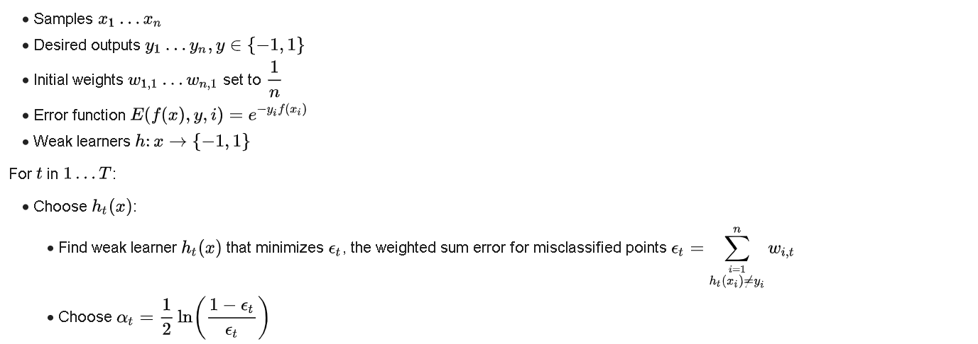
How boosting Algorithms works?

Slide 19
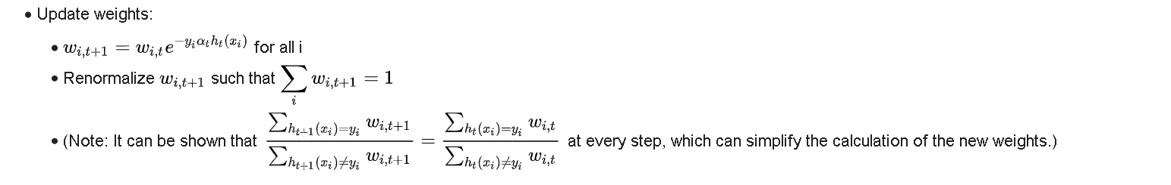
How boosting Algorithms works?

Slide 20
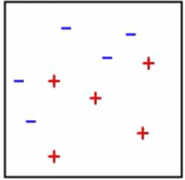
Boosting Example
Classes: +, -
Original dataset, D1

Slide 21
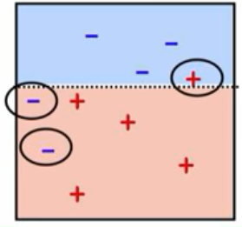
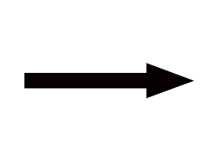
Boosting Example
Original dataset, D1 Trained Classifier

Slide 22
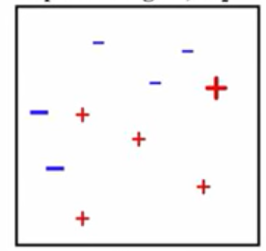
Boosting Example
The observations which are incorrectly predicted, are given higher weights.
Original dataset, D1 Trained Classifier Updated dataset,D2

Slide 23
Boosting Example
Updated dataset, D2

Slide 24
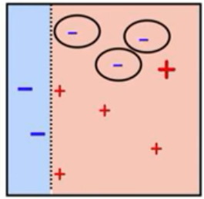
Boosting Example
Updated dataset, D2 Trained Classifier

Slide 25
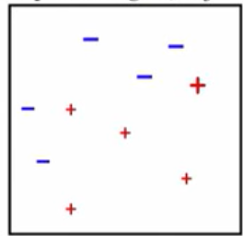
Boosting Example
Updated dataset, D2 Trained Classifier Updated dataset, D3

Slide 26
Boosting Example
Updated dataset, D3

Slide 27
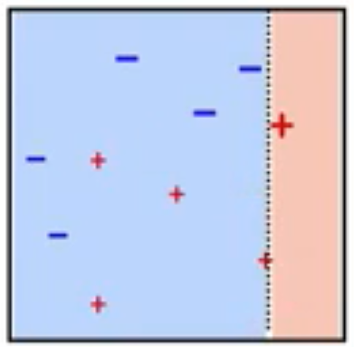
Boosting Example
Updated dataset, D3 Trained Classifier

Slide 28
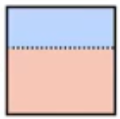
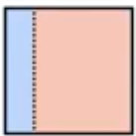
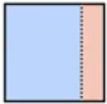
Boosting Example
Combining classifiers:
+ + =

Slide 29
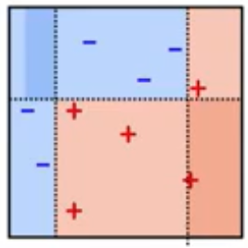
Boosting Example
Here, we have combined D1, D2 and D3 to form a strong prediction having complex rule as compared to individual weak learner. This algorithm has classified these observation quite well as compared to any of individual weak learner.
+ + =

Slide 30
Important Points on Boosting:
Focus new experts on examples that others get wrong
Train experts sequentially
Combine the whole set in the end
Convert many “weak” learners into a complex classifier

Slide 31
Difference between Bagging and Boosting
In Boosting, each model is built on top of the previous ones. Whereas in bagging each model is built independently.
The final boosting ensemble uses weighted majority vote while bagging uses a simple majority vote.
Bagging is a method of reducing variance while boosting can reduce the variance and bias of the base classifier.
Boosting is better than bagging on non-noisy data.
Bagging is effective more often than boosting

Slide 32
Types of Boosting Algorithms
There are many boosting algorithms which use other types of engine such as:
AdaBoost(Adaptive Boosting)
Gradient Tree Boosting
XGBoost

Slide 33
ADABoost: A meta algorithm to solve high bias problem
ADABoost is a complex meta algorithm that is used to combine weak learners into strong ones.
It is regarded as a powerful algorithm to reduce bias, i.e, to make the data fit better than it already does.
Most common way to illustrate ADABoost is to combine it with Decision Trees and Random Forests.
Decision Trees and Random Forests have already been explained in previous seminars!

Slide 34
ADABoost
Short for Adaptive Boosting.
A complex meta algorithm.
Difficult to understand.
Examples make it easy.
A brief intro to Decision Trees, Decision Stumps and Random Forests.

Slide 35
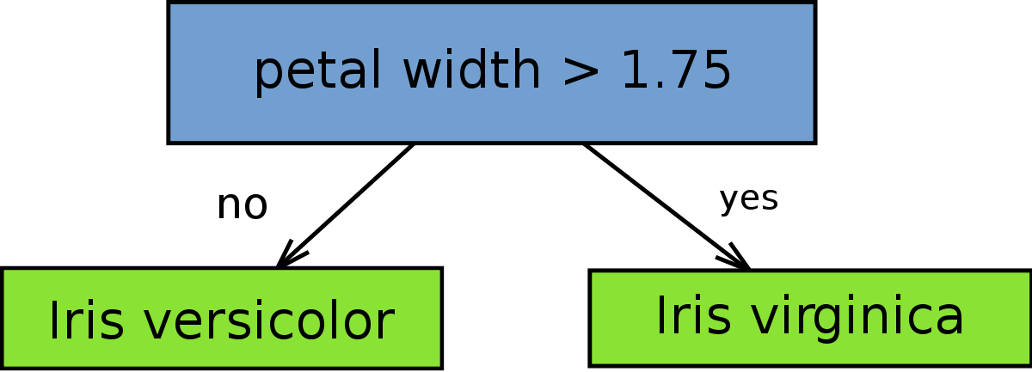
Intro to Decision Stumps
A Decision Stump is simply a decision tree with one root node and two leaf nodes. It has only one criterion for classification. These are often used in ADABoost algorithms.

Slide 36
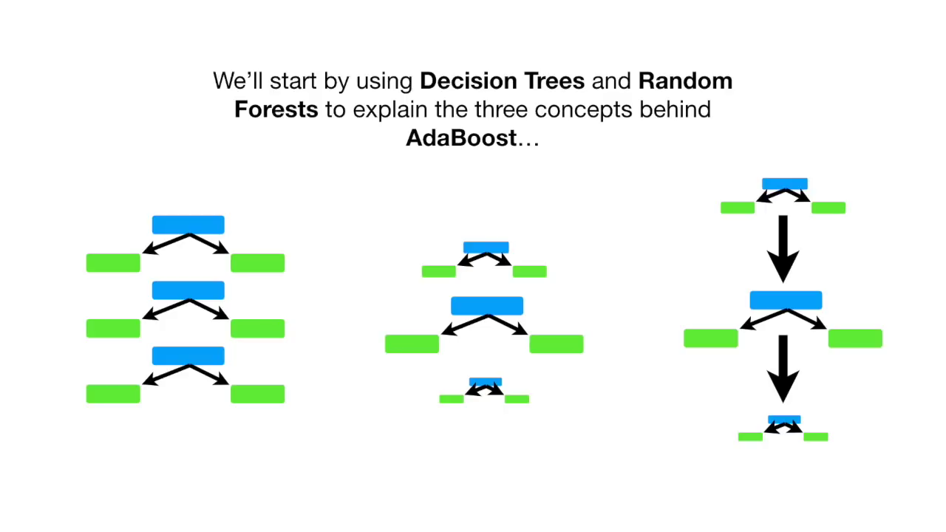

Slide 37
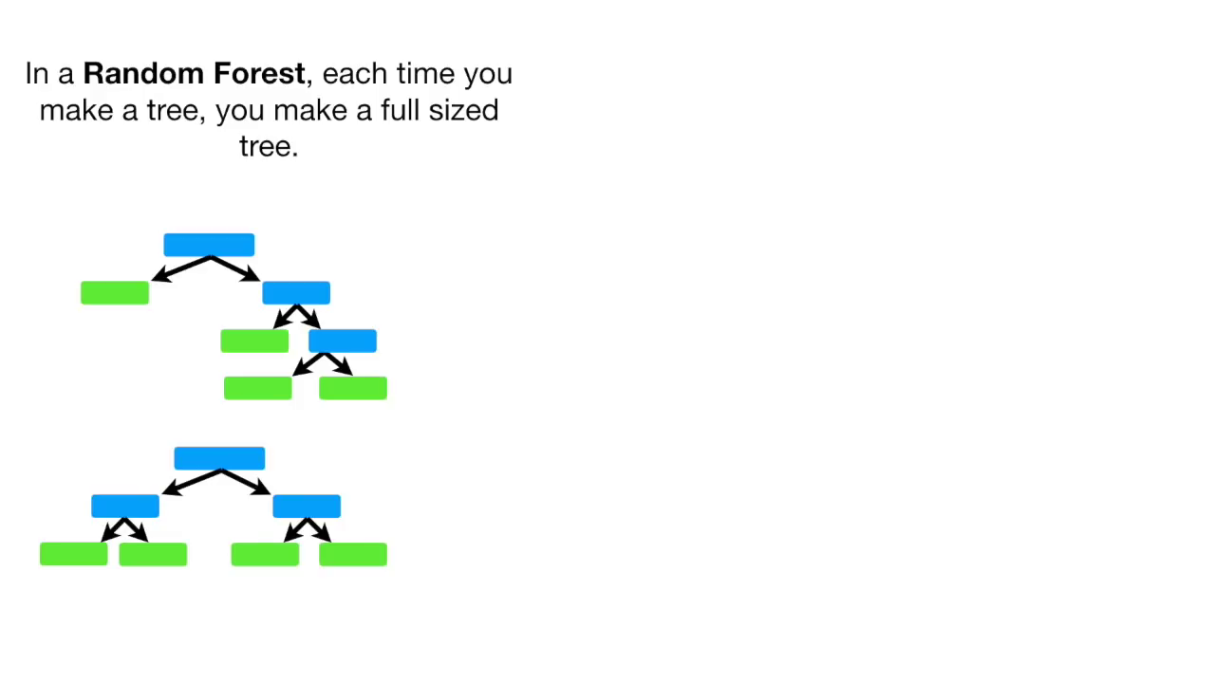

Slide 38
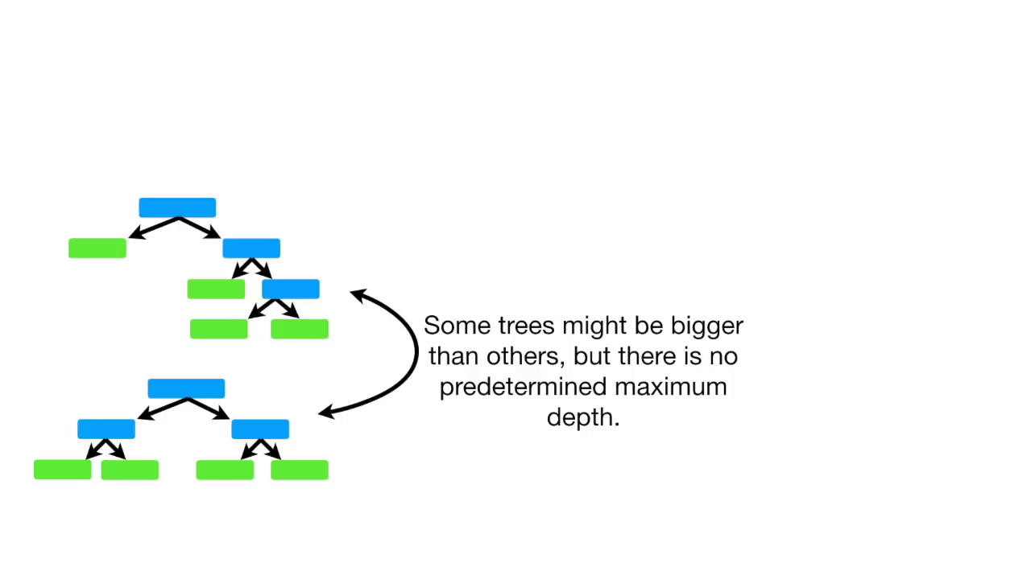

Slide 39
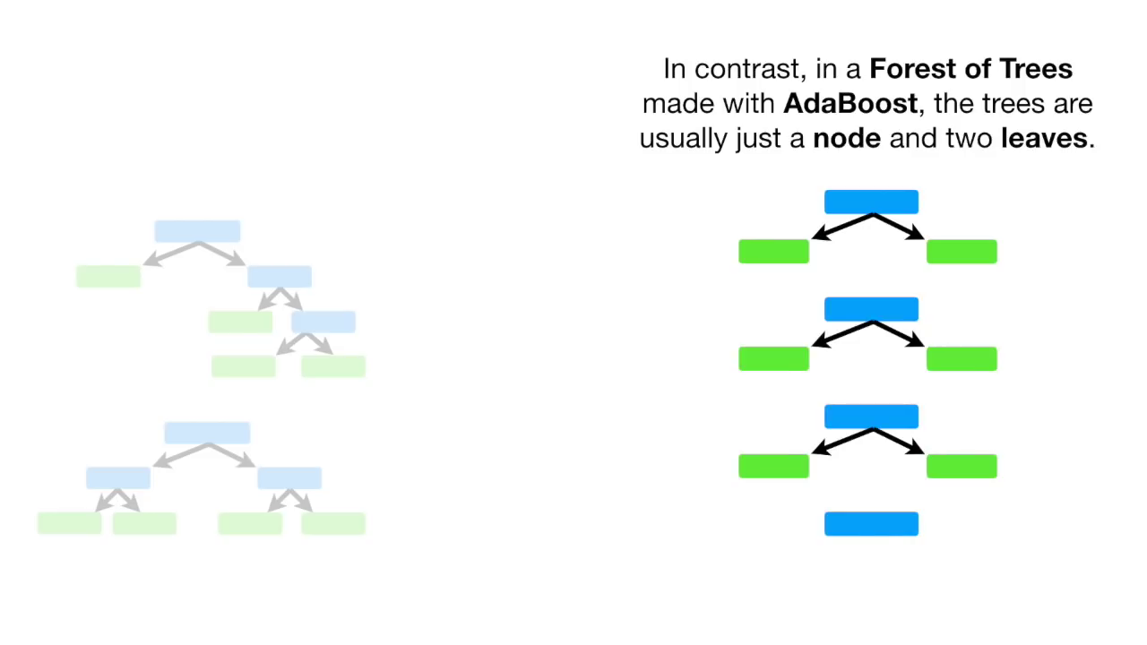

Slide 40
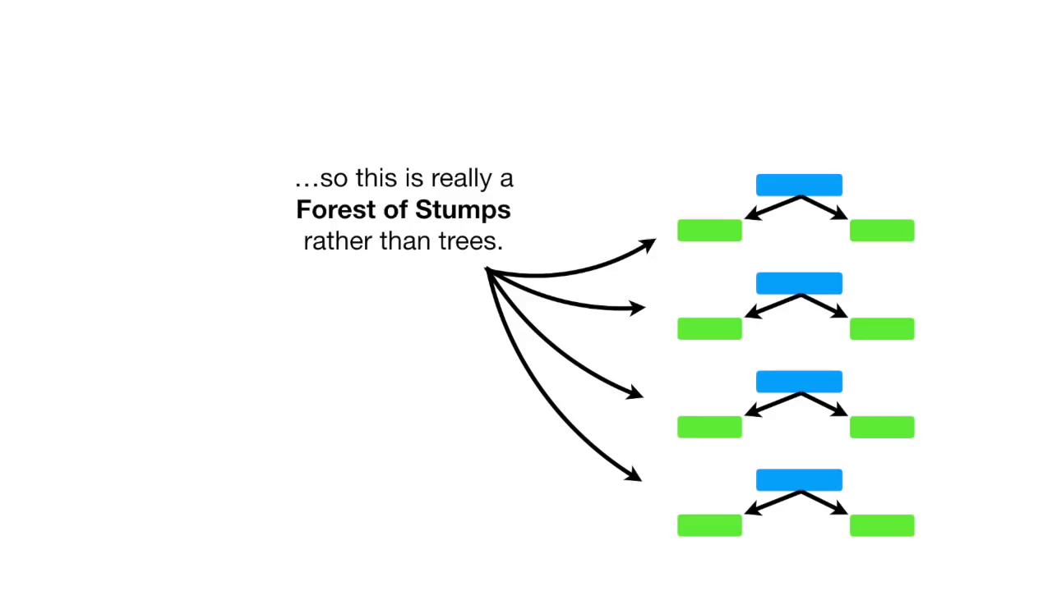

Slide 41
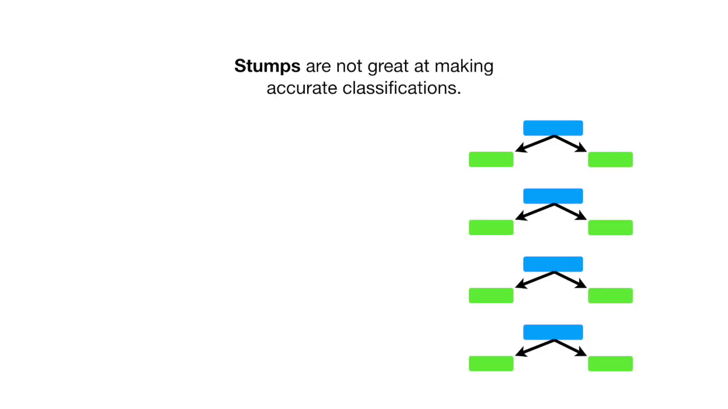

Slide 42
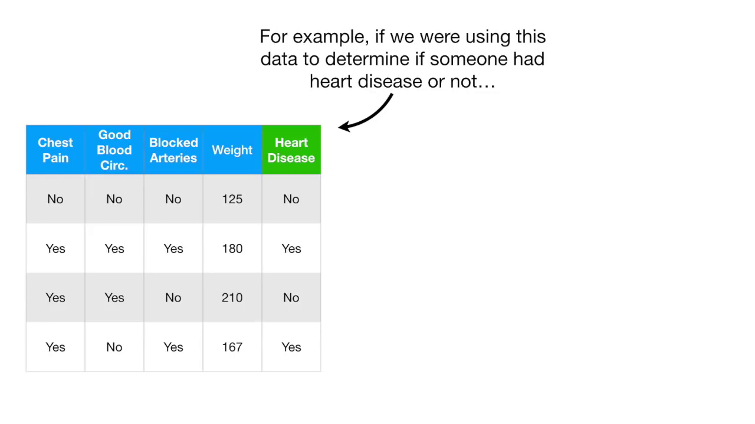

Slide 43
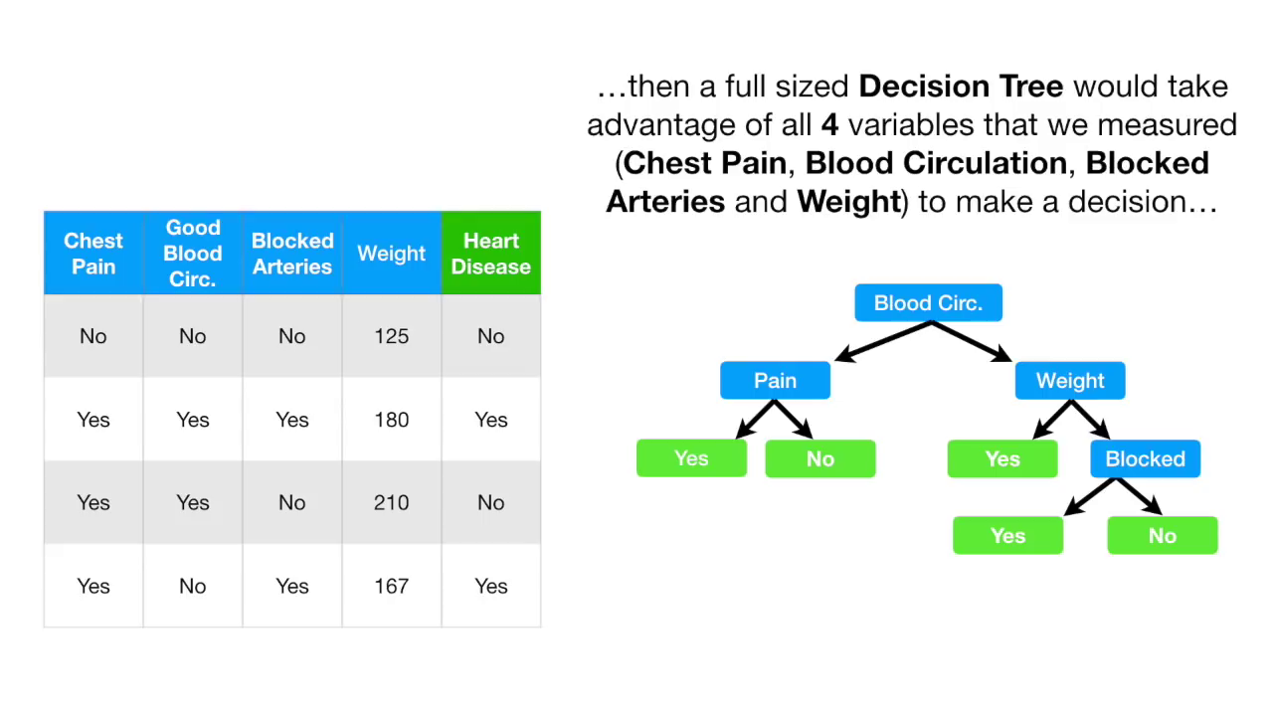

Slide 44
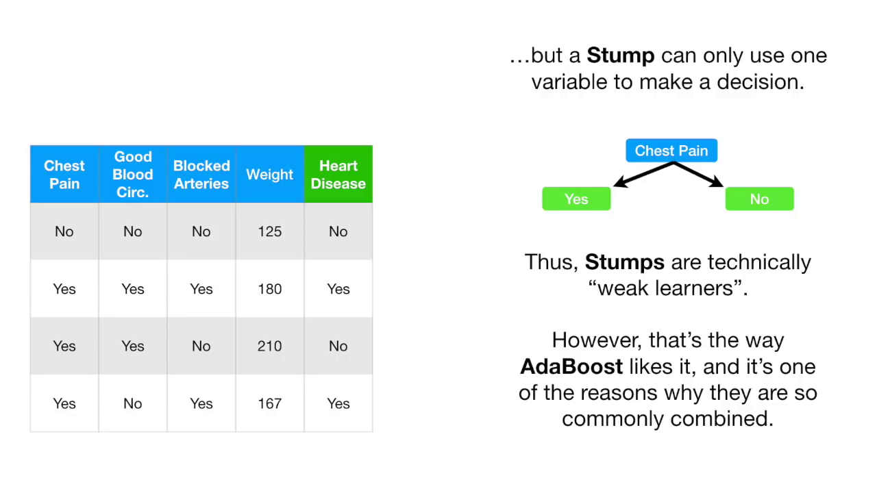

Slide 45
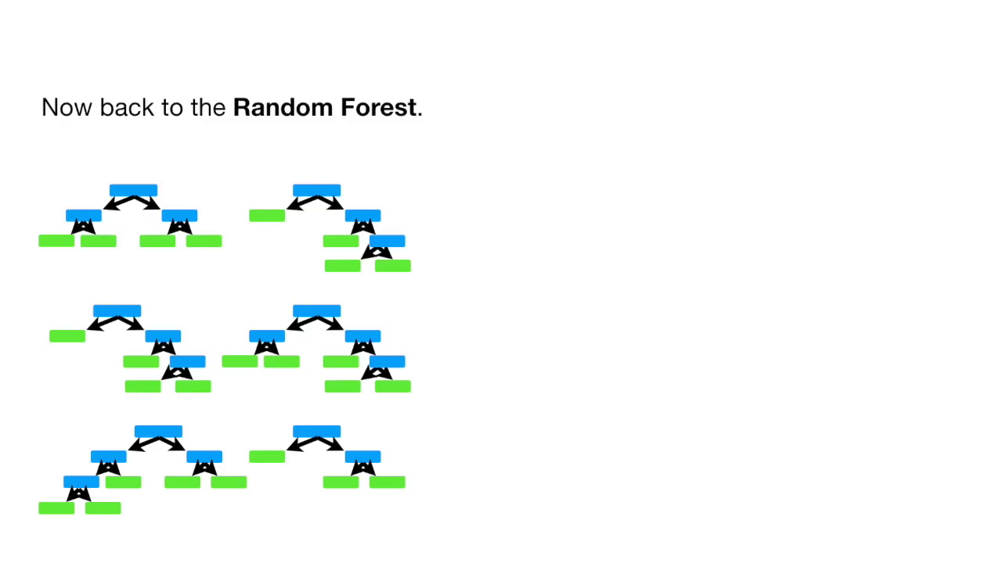

Slide 46
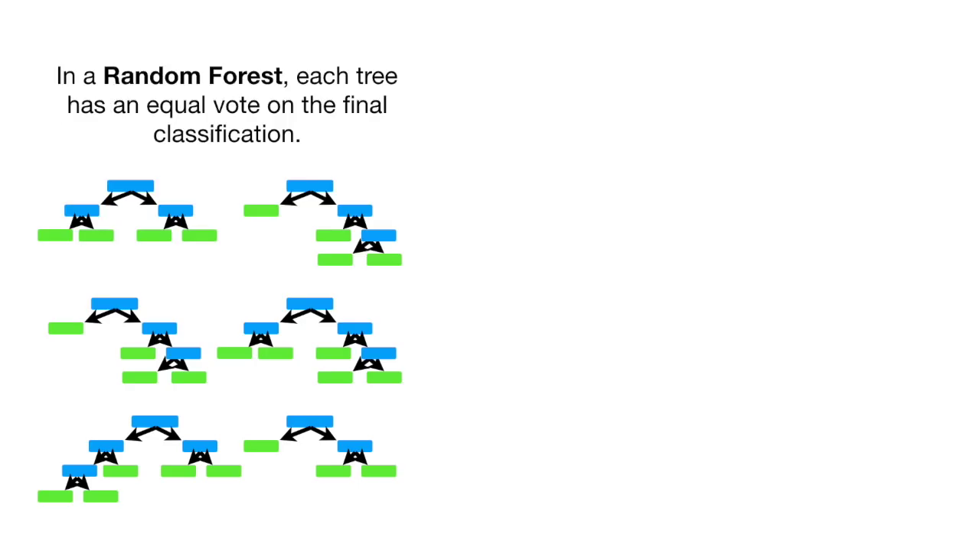

Slide 47
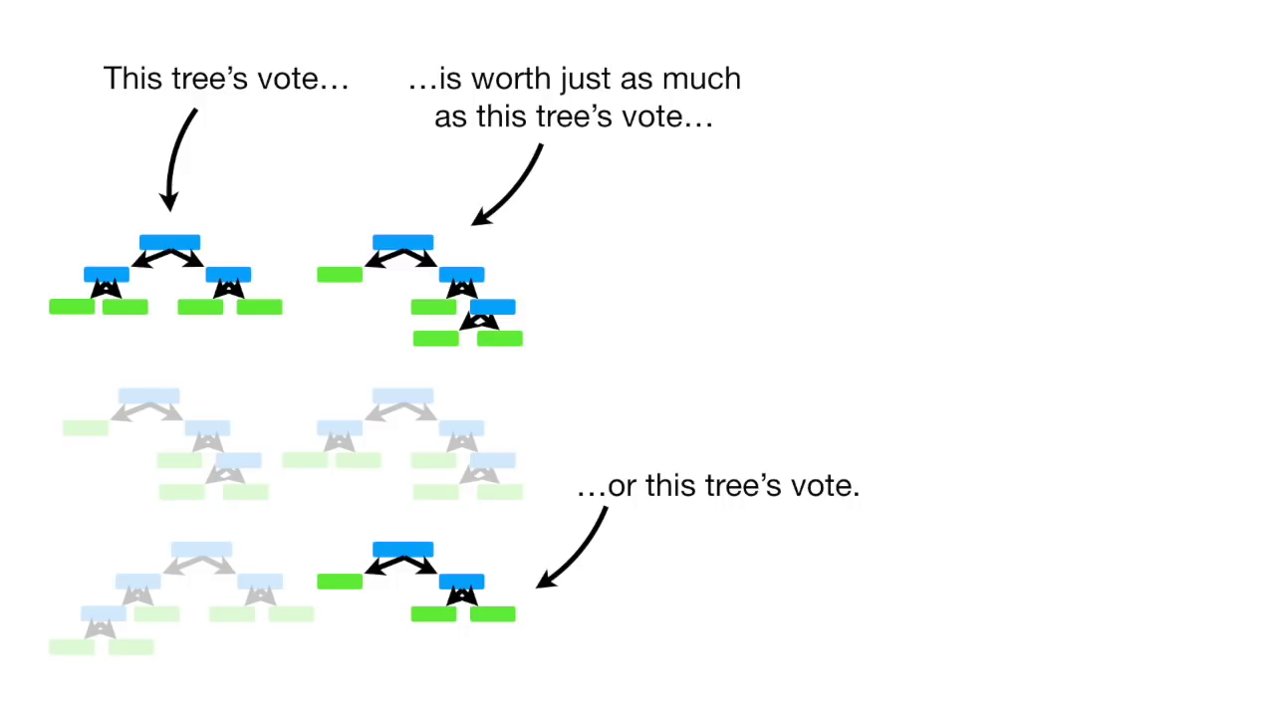

Slide 48
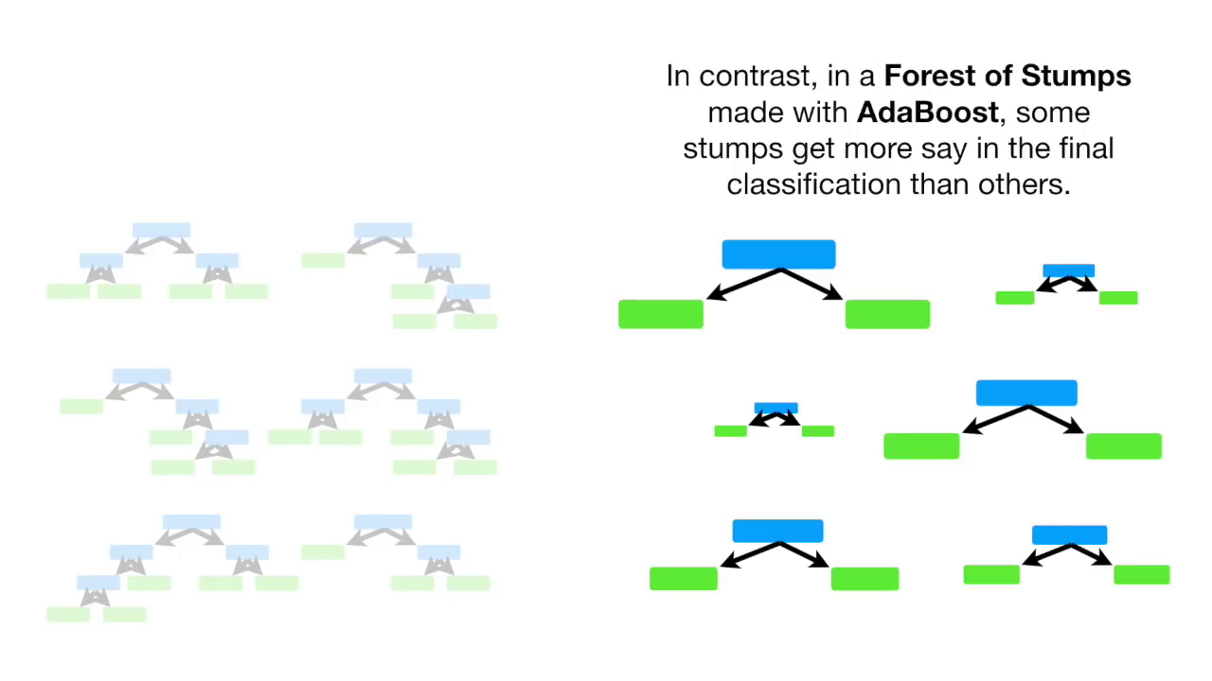

Slide 49
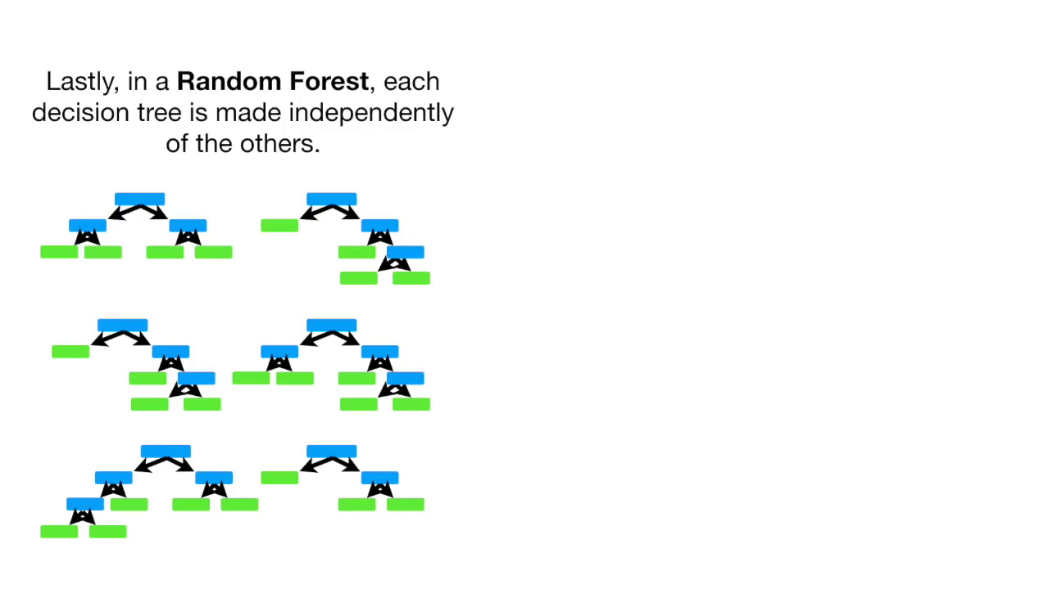

Slide 50
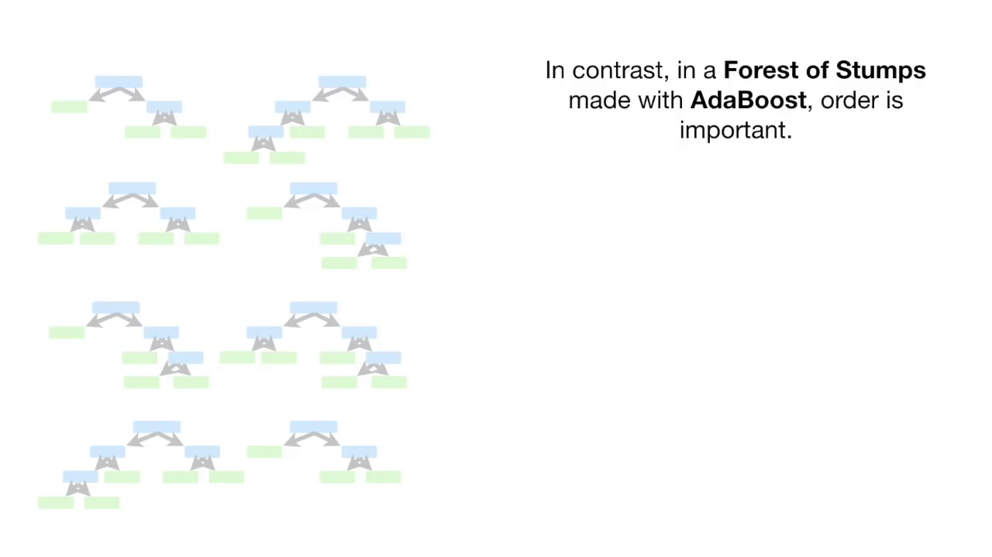

Slide 51
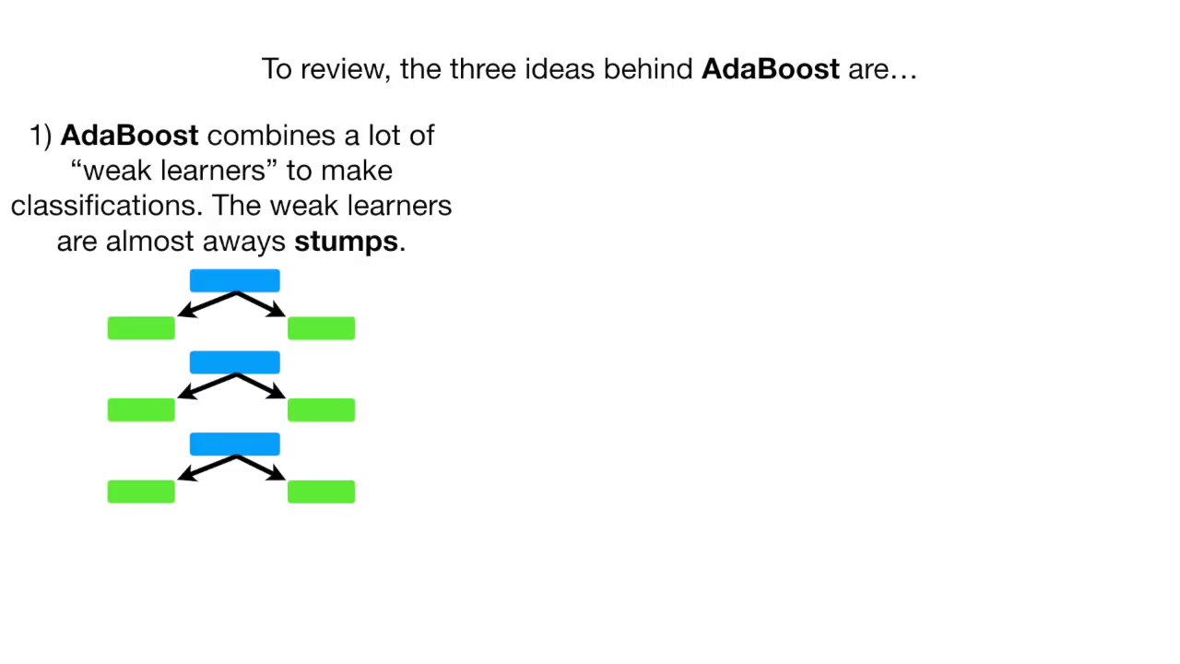

Slide 52
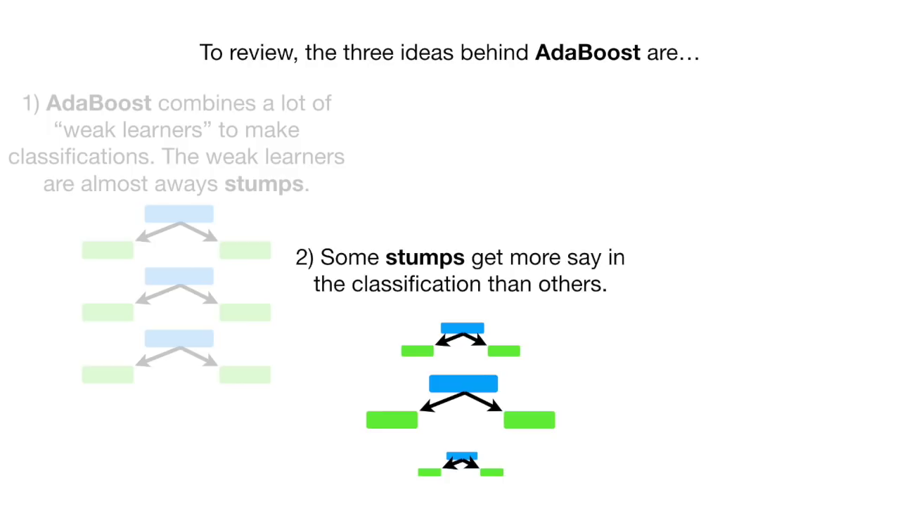

Slide 53
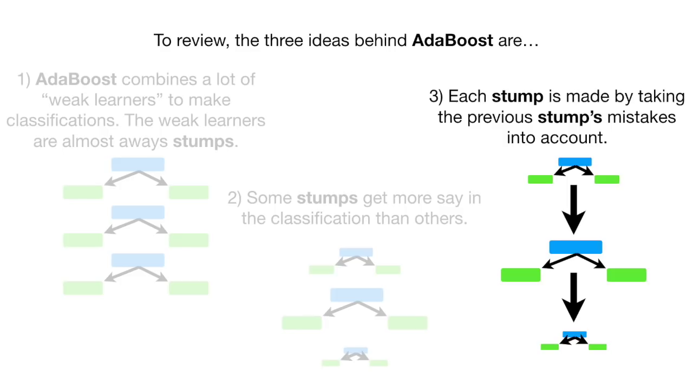

Slide 54
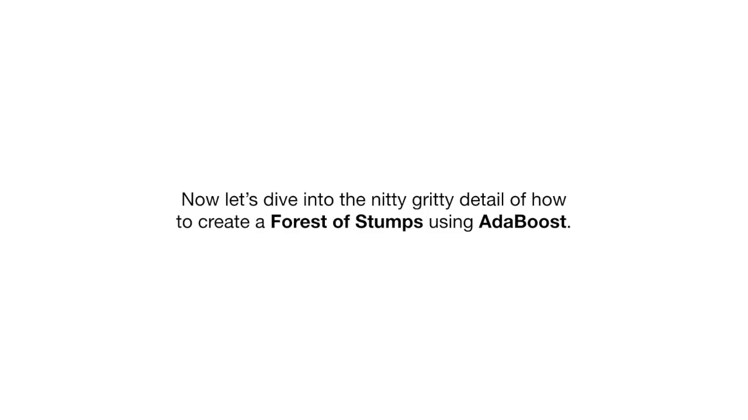
We take a specific example to explain this topic. An example of classification of samples based on several factors.

Slide 55
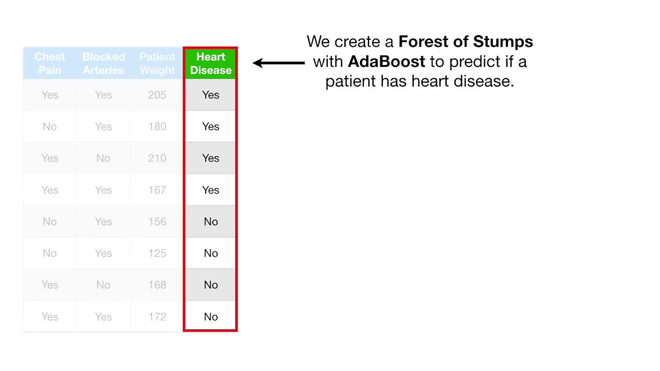

Slide 56
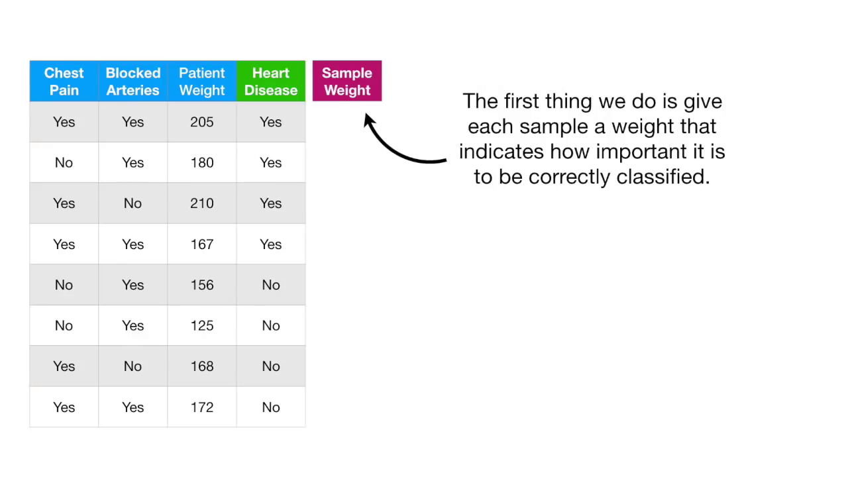

Slide 57
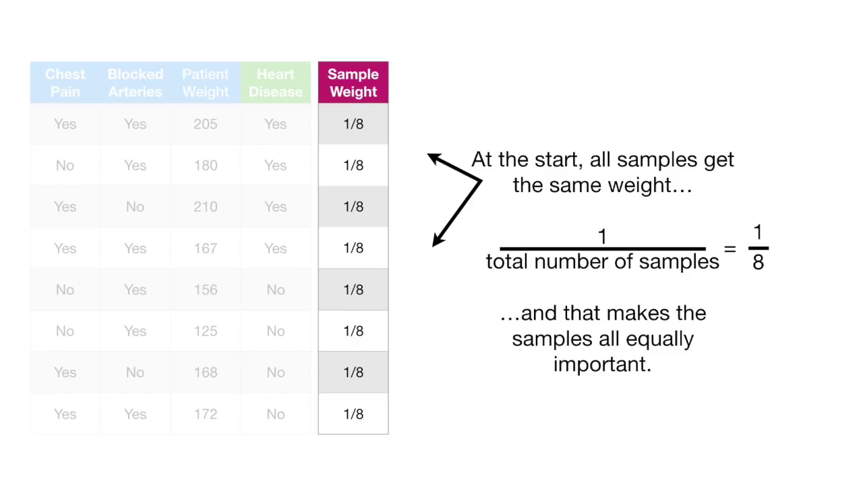

Slide 58
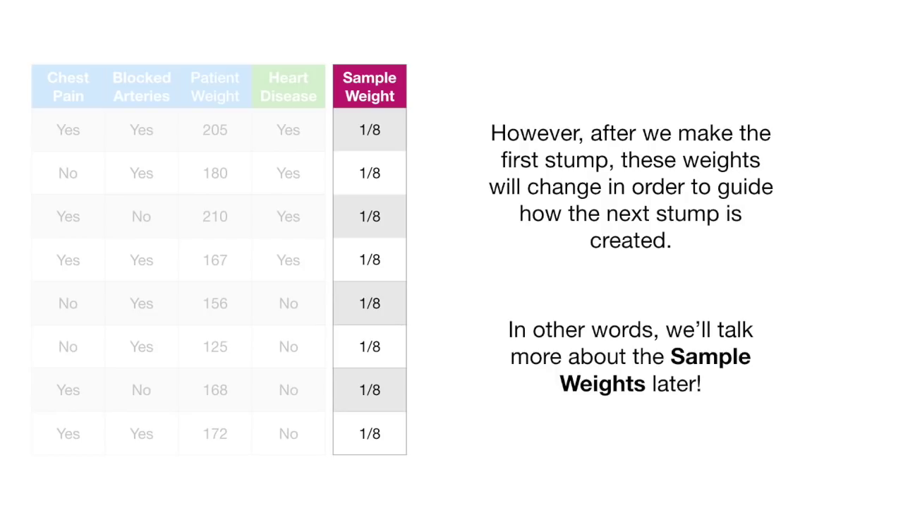

Slide 59
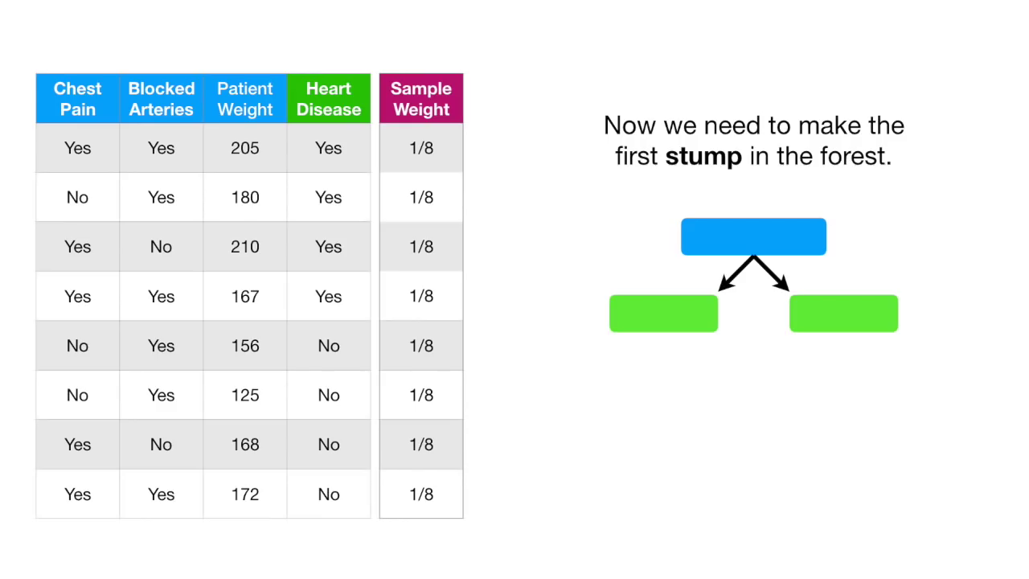

Slide 60
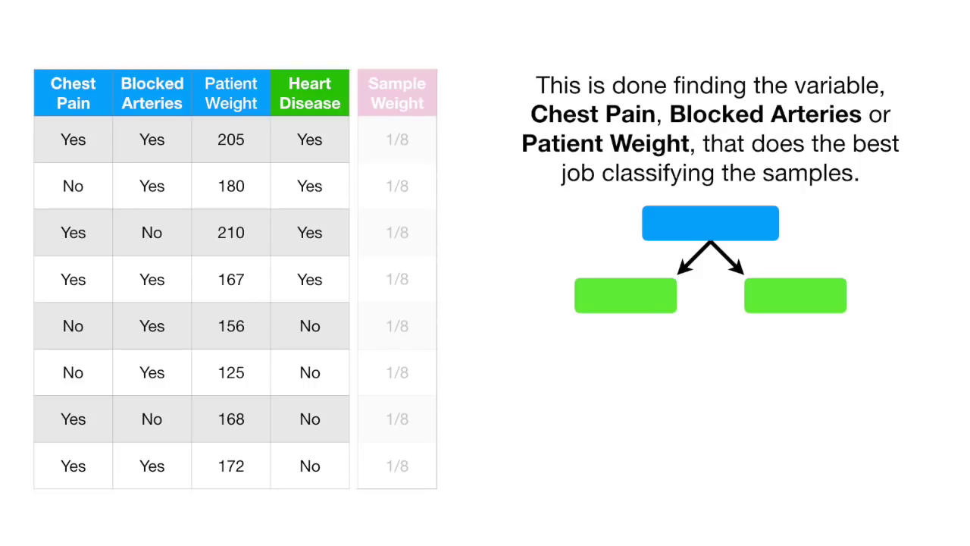

Slide 61
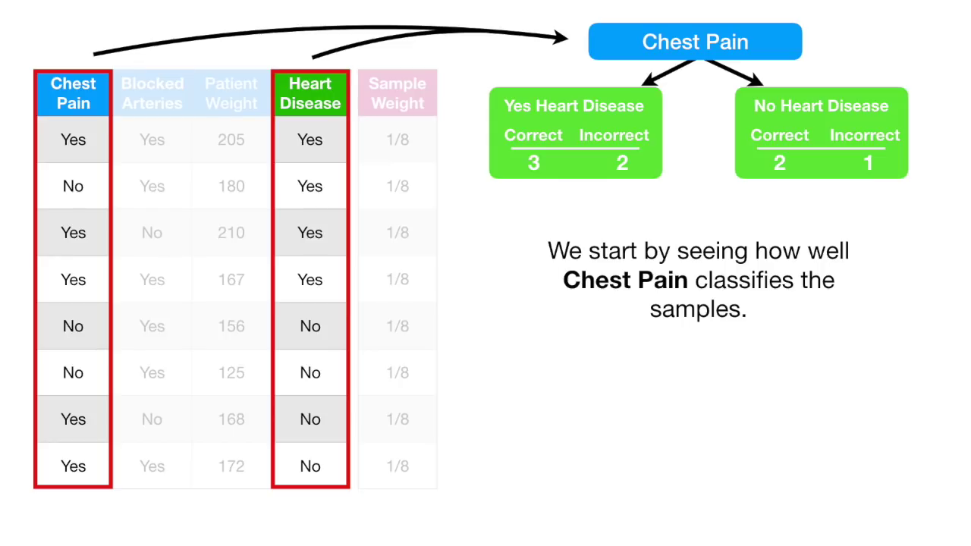

Slide 62
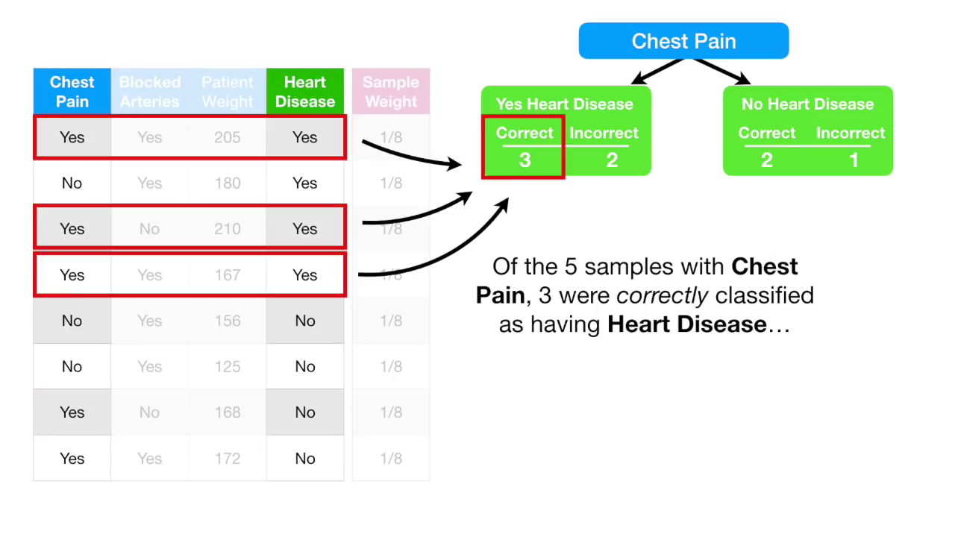

Slide 63
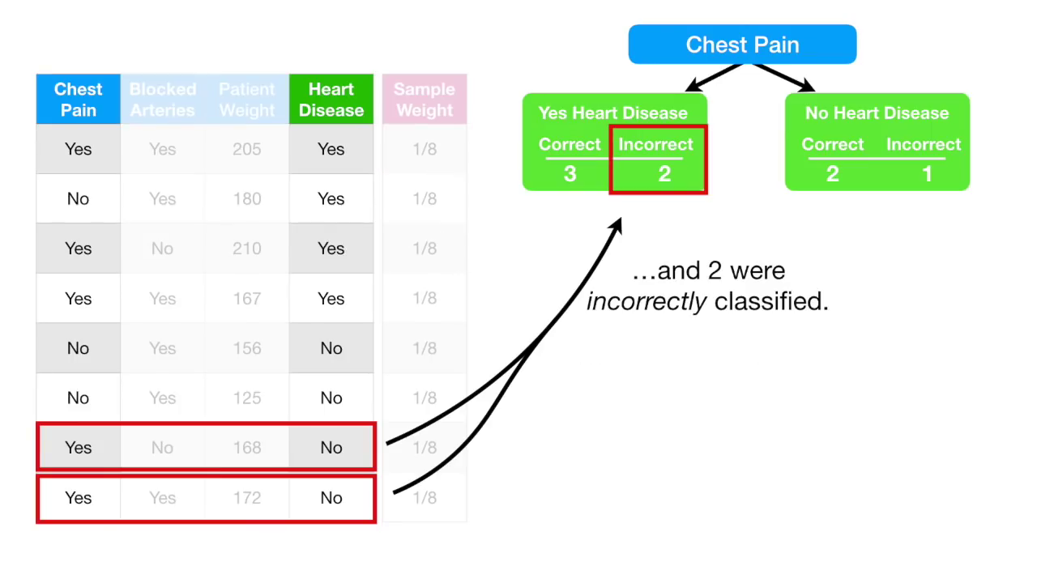

Slide 64


Slide 65


Slide 66


Slide 67


Slide 68


Slide 69


Slide 70


Slide 71


Slide 72


Slide 73


Slide 74


Slide 75


Slide 76


Slide 77


Slide 78


Slide 79


Slide 80


Slide 81


Slide 82


Slide 83


Slide 84


Slide 85


Slide 86


Slide 87


Slide 88


Slide 89


Slide 90


Slide 91


Slide 92


Slide 93


Slide 94


Slide 95


Slide 96


Slide 97


Slide 98


Slide 99


Slide 100


Slide 101


Slide 102


Slide 103


Slide 104


Slide 105


Slide 106


Slide 107


Slide 108


Slide 109


Slide 110


Slide 111


Slide 112


Slide 113


Slide 114


Slide 115


Slide 116


Slide 117


Slide 118


Slide 119


Slide 120


Slide 121


Slide 122


Slide 123


Slide 124

And then a third stump, and so on...

Slide 125
Conclusions and Takeaway
ADABoost algo takes weak learners as input and converts them into strong ones, the primary idea behind Boosting.
AdaBoost works by putting more weight to classify incorrect instances and less on those already handled well.
AdaBoost algorithms can be used for both classification and regression problems.
Here is a good source if you want to understand the maths behind it.

Slide 126
Questions!
Why do want to use “weak” learners when boosting?
How do you think in decision trees, the best variable is selected to classify?

Slide 127
THANK YOU

